Slide 1
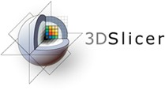


Dcm2niixGUI Tutorial
Laura Leung
Harvard Medical School

Slide 2
Diffusion Weighted Imaging (DWI)
Type of MR imaging based on the measurement of Brownian motion of water molecules
Useful method in mapping the fiber architecture of tissue

Slide 3
Learning Objectives
Inputting DICOM DWI Files into Slicer using the Dcm2niiGUI module
Divide folders containing multiple MR acquisitions or series into isolated folders using the DICOM Patcher module

Slide 4
Tutorial Dataset
The tutorial dataset can be found here under DWIDICOM
http://slicer.kitware.com/midas3/folder/5039
Files should contain:
MR_0004_0028.dcm
[...]
MR_0004_1800.dcm

Slide 5
3D Slicer
This tutorial uses the 3D Slicer (Version 4.10.2, revision 28257, Stable Release)
Available for download at: https://download.slicer.org/
Disclaimer: It is the responsibility of the user of 3DSlicer to comply with both the terms of the license and with the applicable laws, regulations and rules. Slicer is a tool for research, and is not FDA approved.

Slide 6
DICOM Patcher
The Dcm2niixGUI works on DICOM files that contain data from a single MR acquisition.
If there are datasets from multiple MR acquisitions in the input DICOM directory, the DICOM Patcher module can be used to extract each individual dataset before applying Dcm2niixGUI.
Please see the slides on Page 17 for how to used the DICOM Patcher

Slide 7
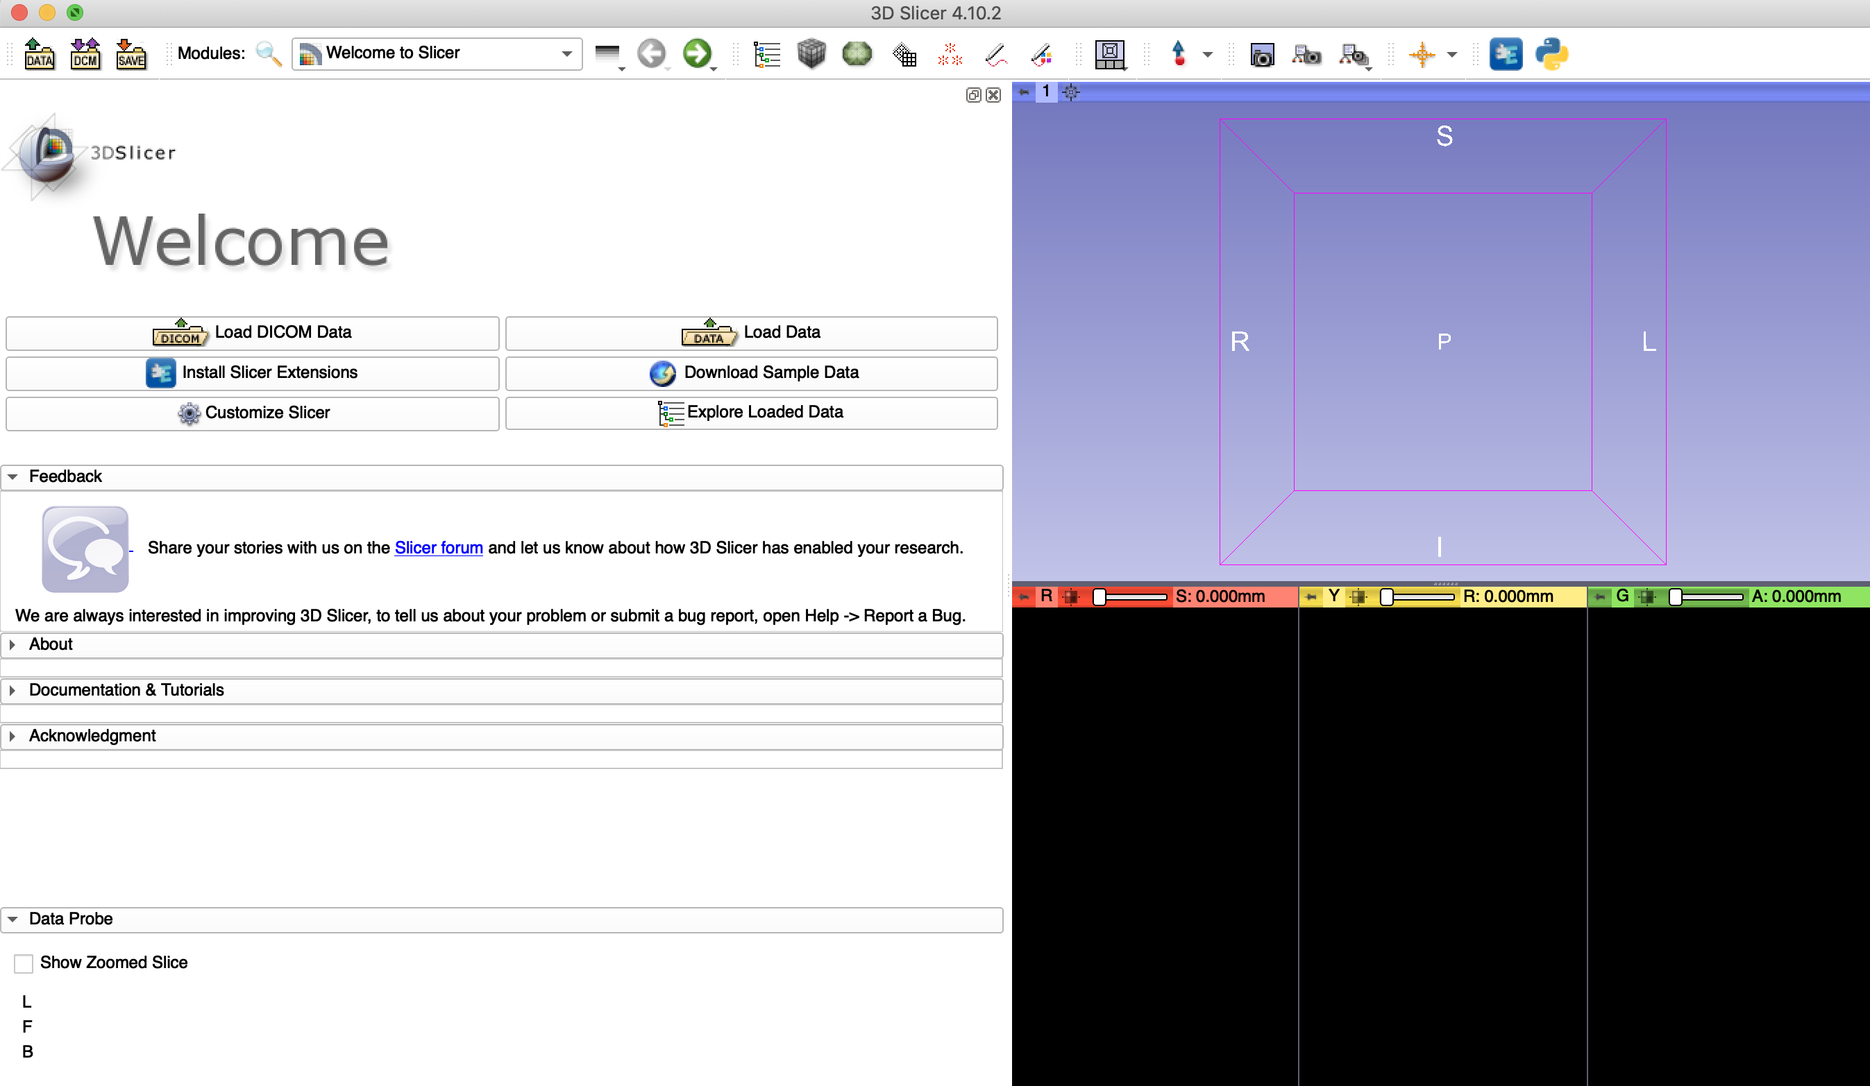
Dcm2niixGUI
To install the module, first click on Install Slicer Extensions (launches extension manager)

Slide 8
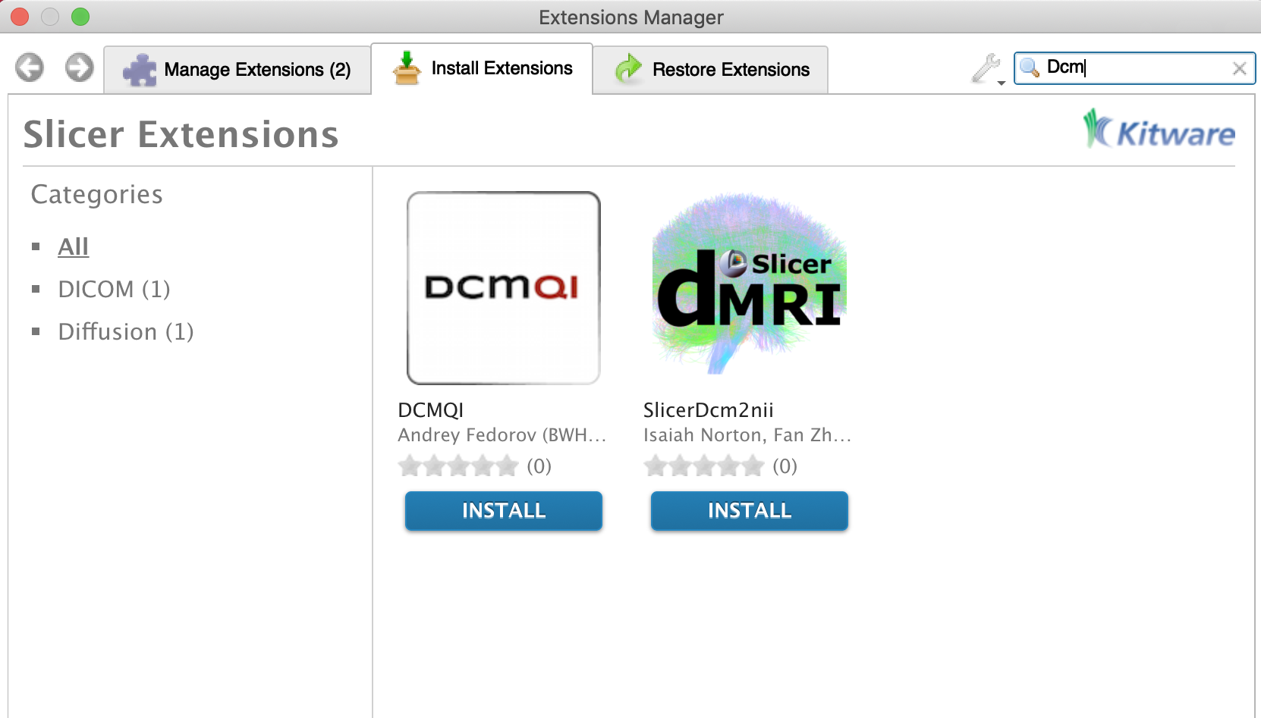
Dcm2niixGUI
1. Search for SlicerDcm2nii in Extension Manager
2. Click Install

Slide 9
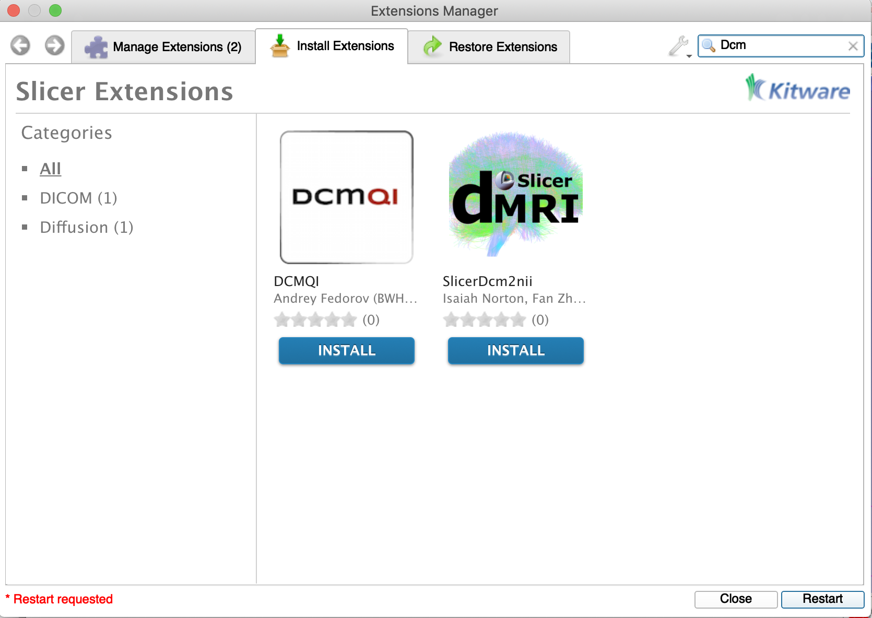
Dcm2niixGUI
Restart Slicer to finish installation

Slide 10
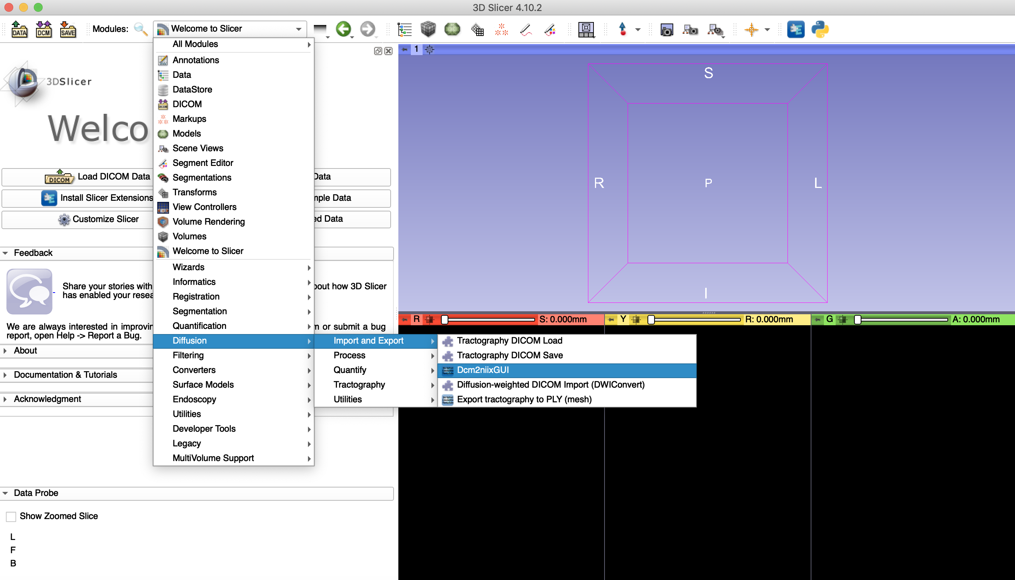
Dcm2niixGUI
To open the module, go to:
Modules
↓
Diffusion
↓
Import and Export
↓
Dcm2niixGUI

Slide 11
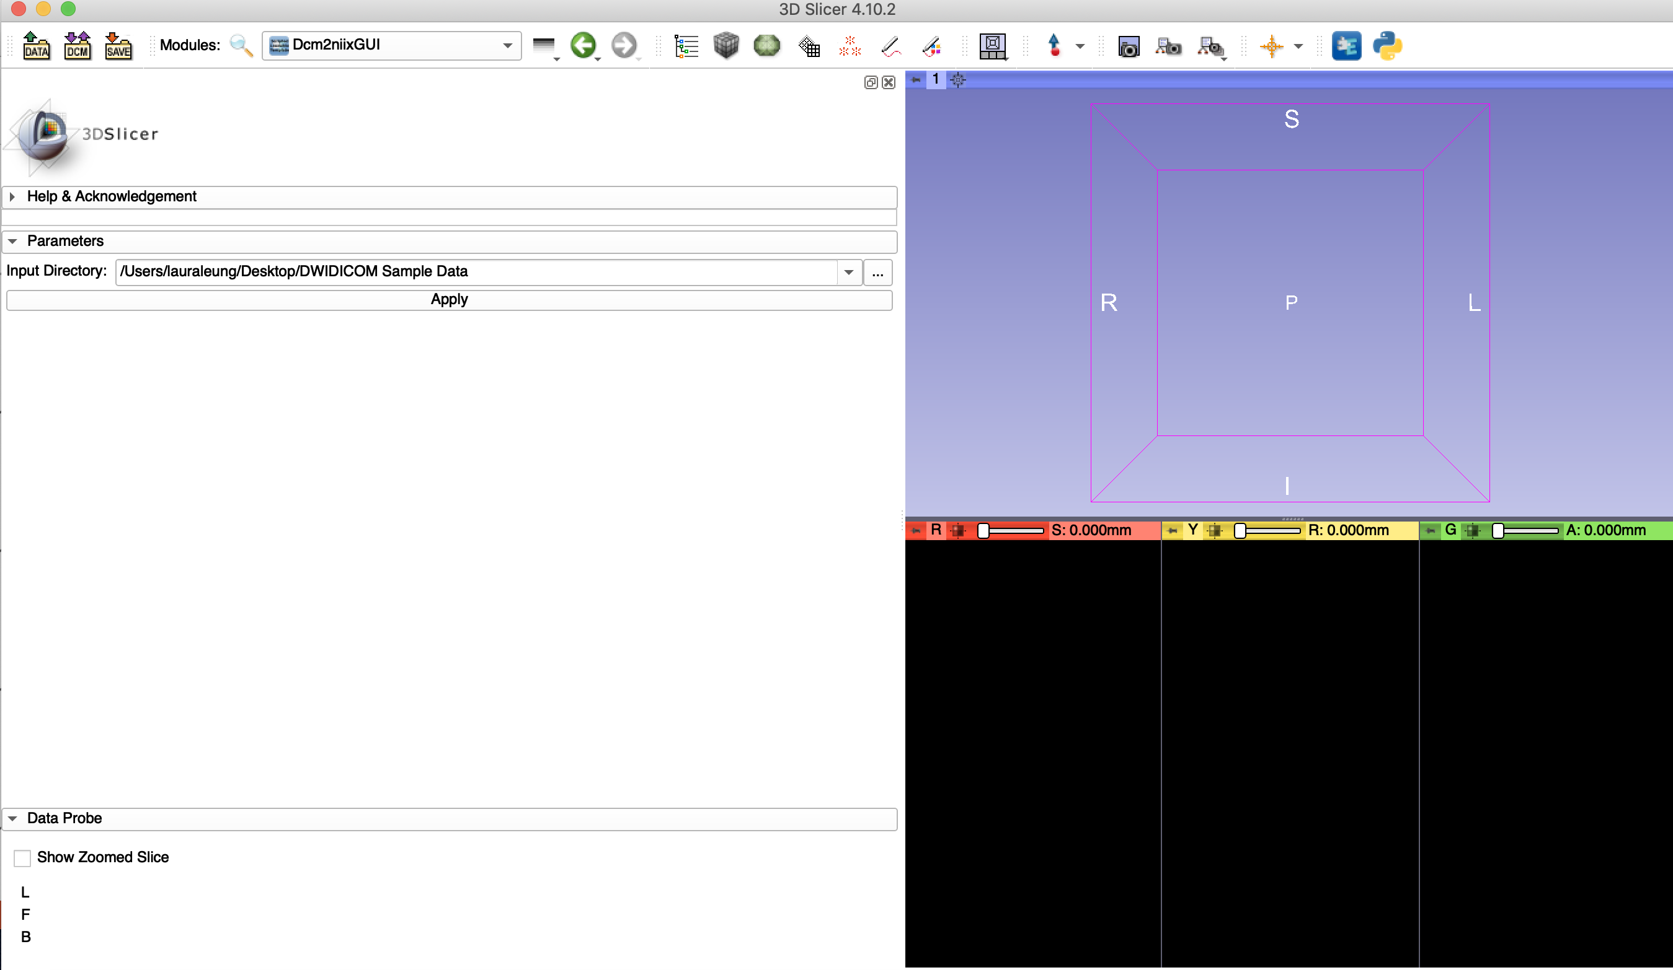
Dcm2niixGUI

Slide 12
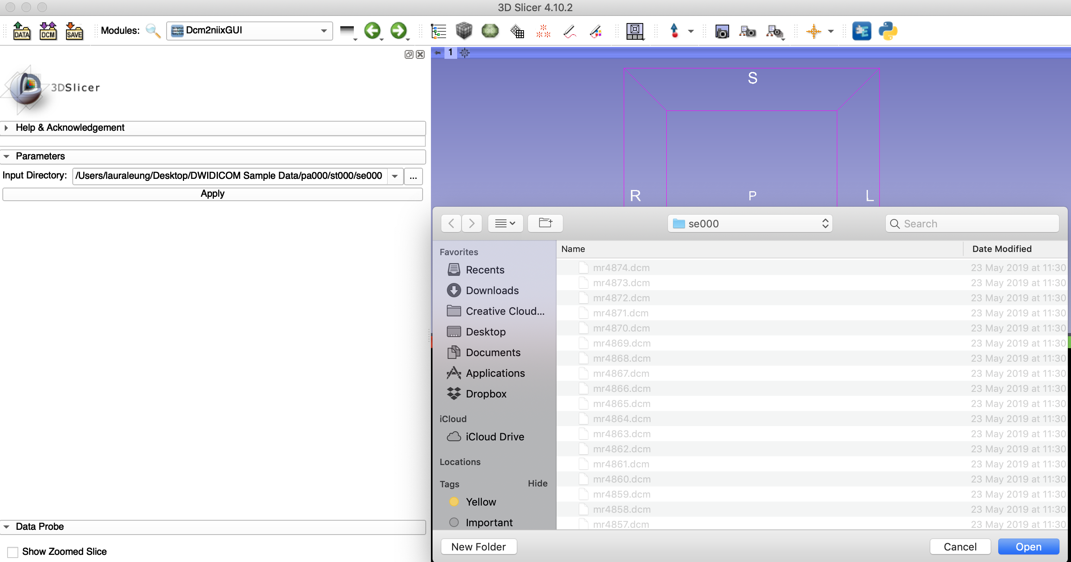
Dcm2niixGUI
2. Select folder containing DICOM files (make sure the folder ONLY contains files from a single DWI DICOM acquisition)
1. Click here to select the desired folder

Slide 13
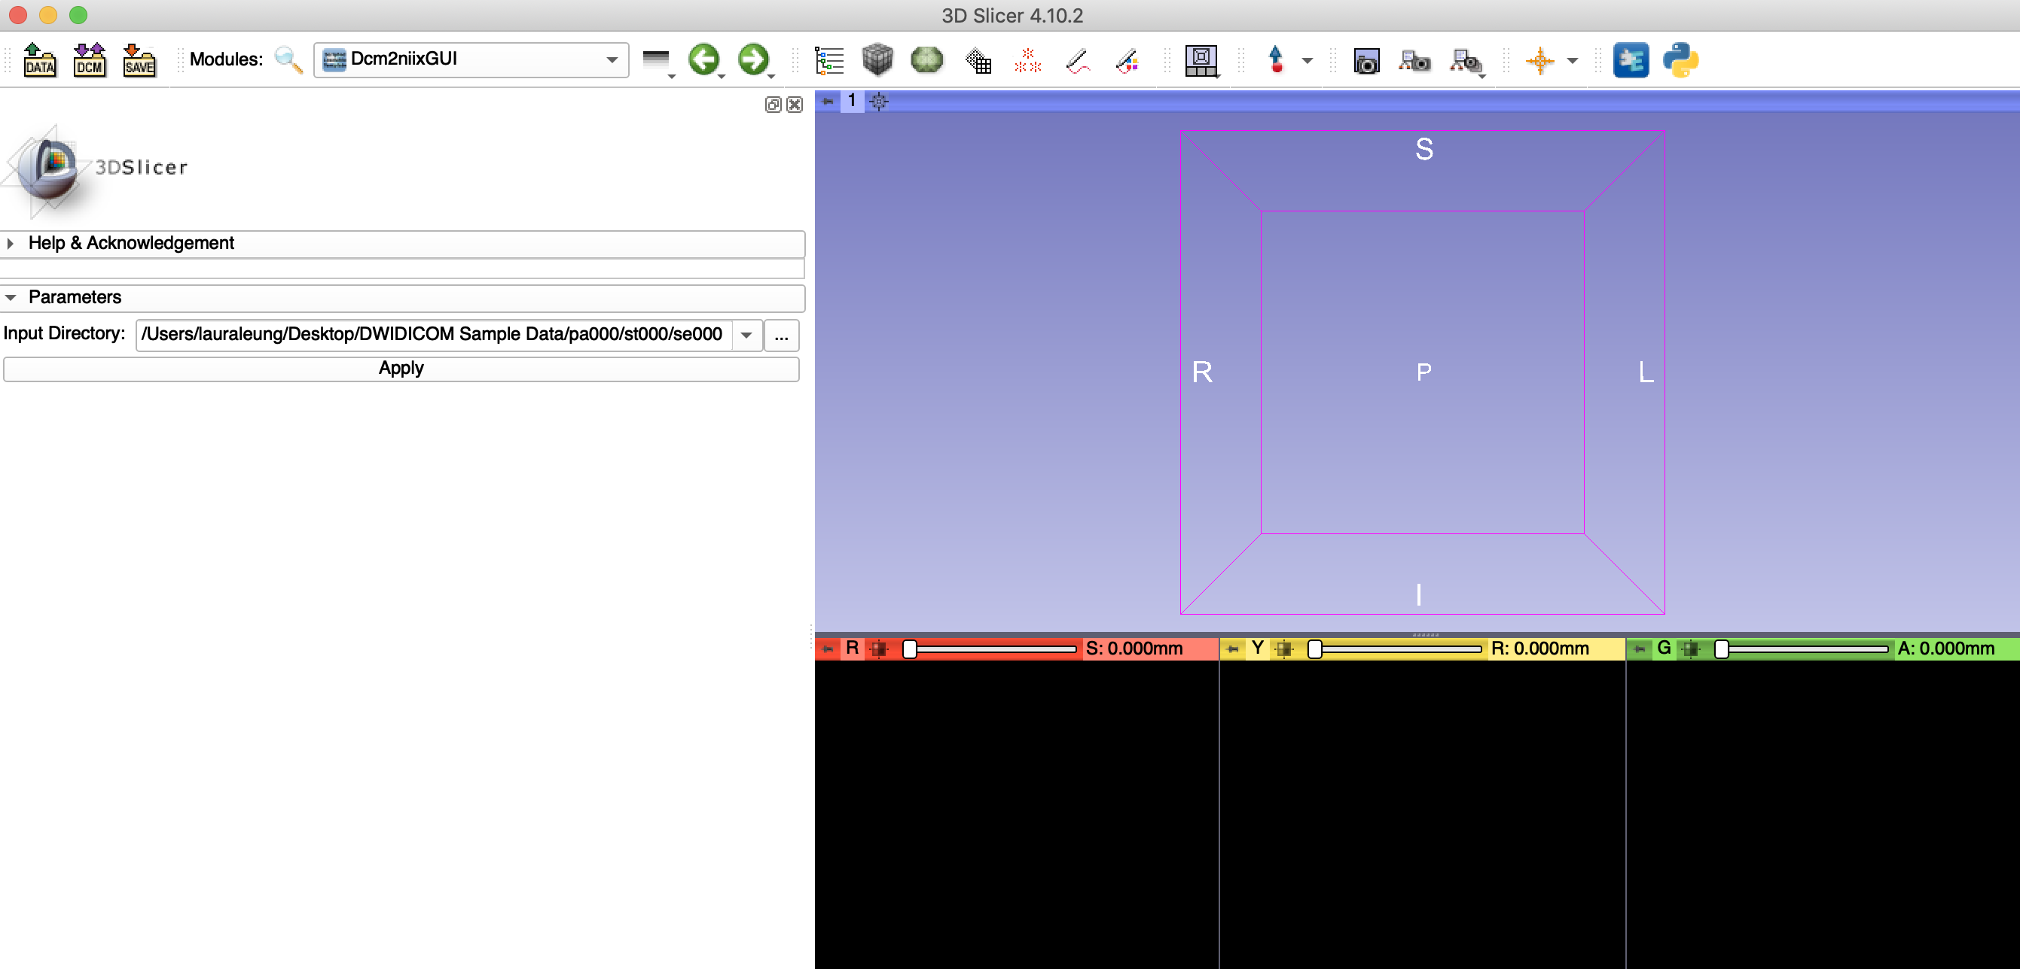
Dcm2niixGUI
1. Check you picked the desired folder!
2. Click Apply

Slide 14
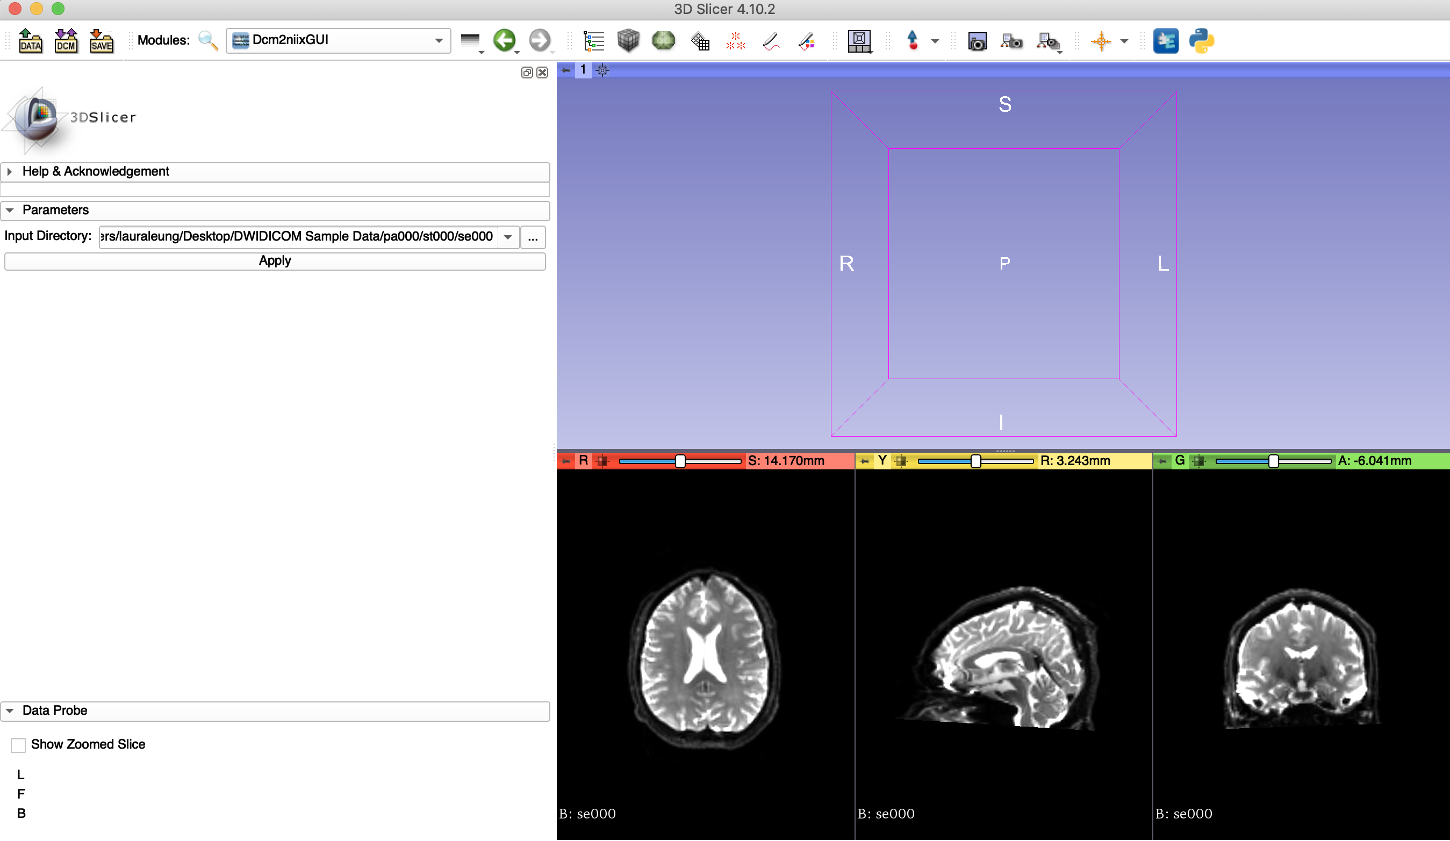
Dcm2niixGUI
DWI DICOM files have been loaded into 3D slicer

Slide 15
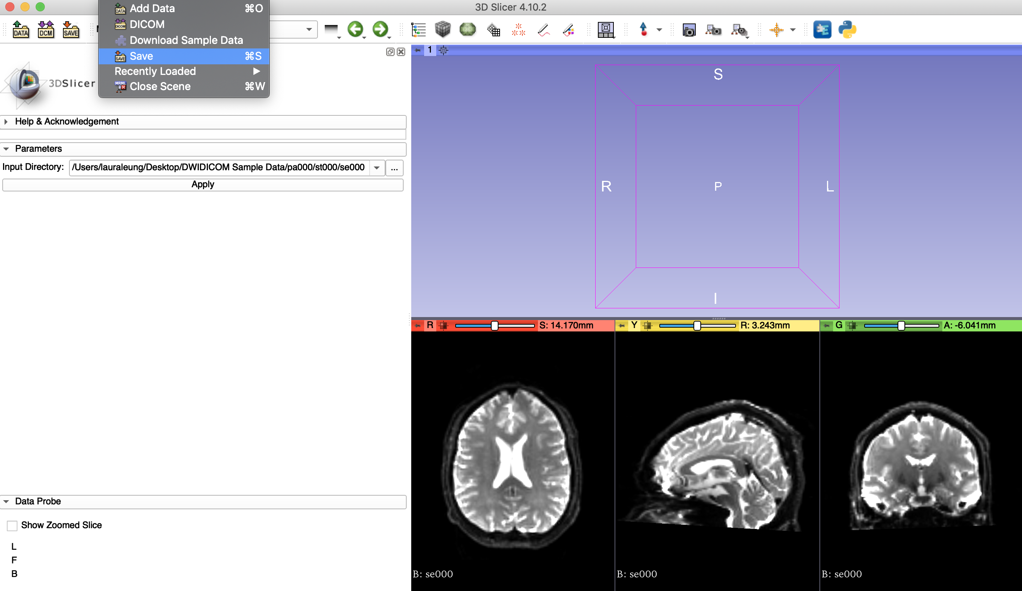
Dcm2niixGUI
To save the DWI Output:
File
↓
Save

Slide 16
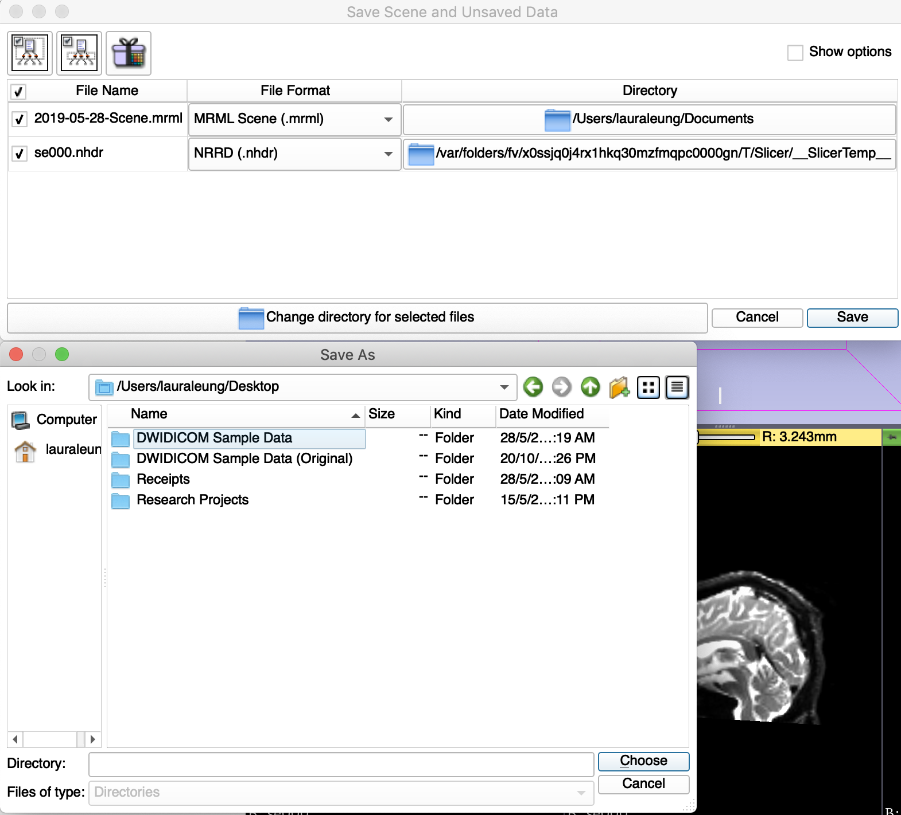
Dcm2niixGUI
3. Click here to save!
1. Choose to save the file as either nhdr/nrrd
2. Click here to change the folder for all file outputs

Slide 17
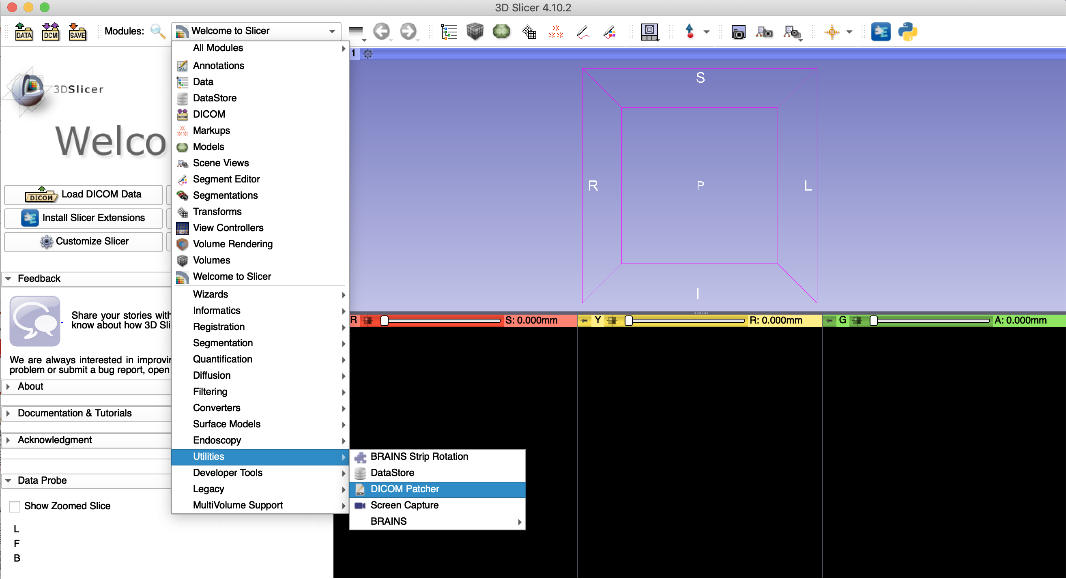
DICOM Patcher
DICOM Patcher is specifically used when a folder has more than one acquisition or series. Run DICOM Patcher to make sure there is only one set of DICOM files within your input folder.
Modules
↓
Utilities
↓
DICOM Patcher

Slide 18
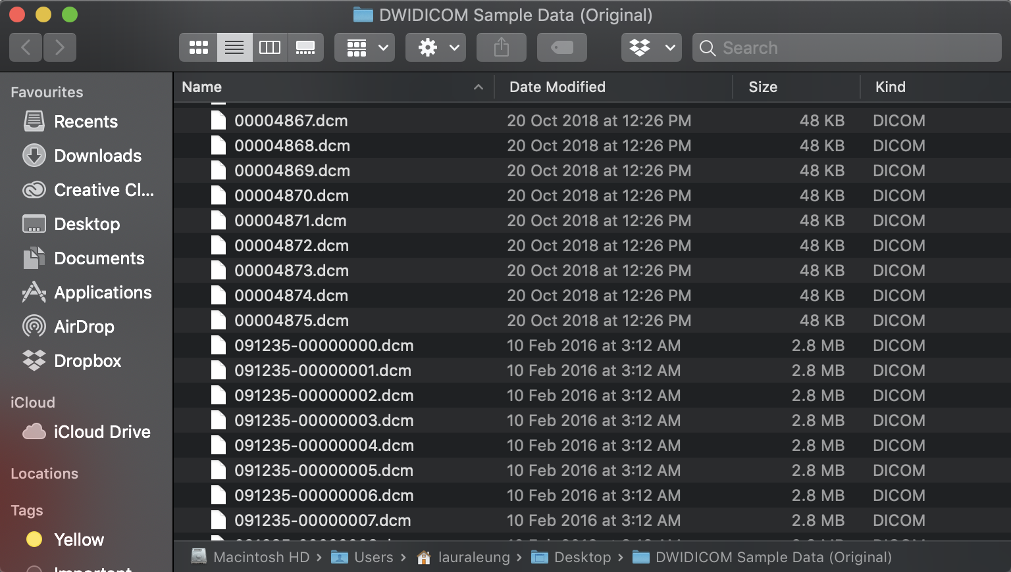
DICOM Patcher
Take this as an example – there is data from two different patients placed into the same folder.

Slide 19
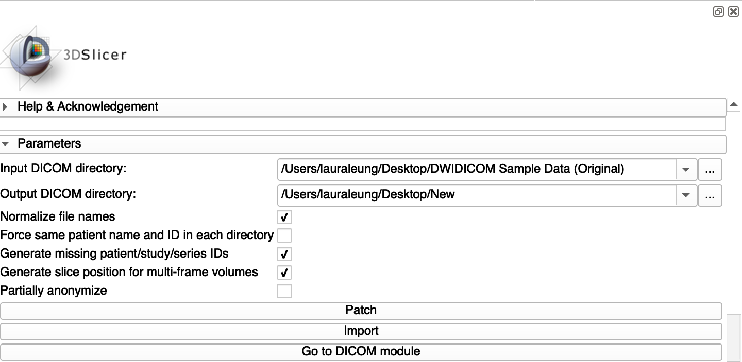
DICOM Patcher
1. Input folder containing DICOM DWI Files (Input DICOM Directory)
2. Input new empty folder for output files (Output DICOM directory)
3. Click Patch to run the module

Slide 20
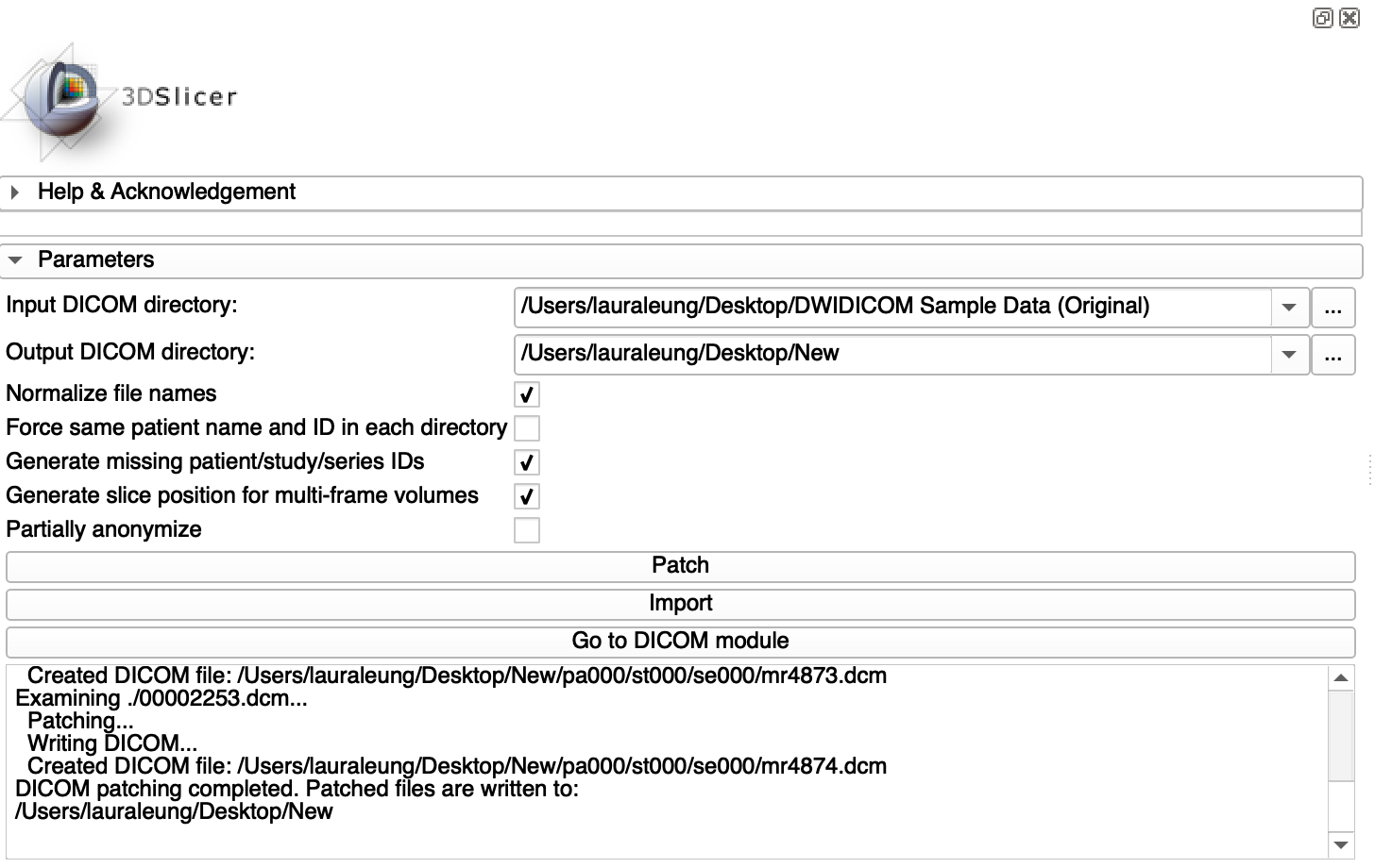
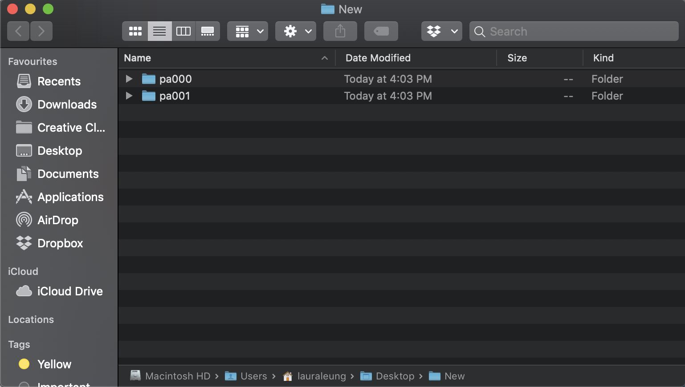
DICOM Patcher
When the process is complete, new folder/folders should be found under your output folder. The resulting output folders can also be used as your input for the Dcm2niiGUI module.

Slide 21
DICOM Patcher
For additional documentation regarding DICOM Patcher, please access the following link
https://slicer.readthedocs.io/en/latest/user_guide/module_dicompatcher.html

Slide 22
Questions/Additional Learning
For additional documentation, please head to:
http://dmri.slicer.org/docs/
To further your knowledge in diffusion MRI processing, the following Slicer DTI tutorials are recommended:
Slicer DTI tutorial http://dmri.slicer.org/tutorials/Slicer-4.8/DiffusionMRIAnalysis.pdf
Slicer UKF tractography tutorial http://dmri.slicer.org/tutorials/Slicer-4.8/UKFTractography.pdf

Slide 23




Acknowledgements
NIH U01CA199459, Open Source Diffusion MRI Technology For Brain Cancer Research
NIH P41EB015898, National Center for Image Guided Therapy (NCIGT) ncigt.org
NIH P41EB015902, Neuroimage Analysis Center (NAC) nac.spl.harvard.edu
National Alliance for Medical Image Computing (NA-MIC) namic.org
Surgical Planning laboratory (SPL) spl.harvard.edu

